Slide 1

Gen Z Career Aspirations: A Comprehensive Analysis
This presentation explores the findings of a research project titled "Understanding the Career Aspirations of Gen Z," providing insights into the professional goals, motivations, and expectations of Generation Z individuals entering the workforce.
by Rihana Fairose

Slide 2

Project Overview
Purpose
Target Audience
The project aims to understand the career aspirations of Gen Z, providing insights into their preferred work environments, motivations, and career choices.
This research is valuable for employers, educators, and policymakers seeking to align their strategies with the needs and aspirations of Gen Z.

Slide 3

Project Summary
Generation Z, born between 1997 and 2012, is entering the workforce with unique aspirations shaped by technology, social values, and economic changes. This project investigates key elements such as job preferences, work-life balance, salary expectations, skills development, and the impact of workplace culture on career decisions. Data was collected through surveys, interviews, and secondary research, analyzed using data visualization techniques to extract meaningful trends and insights

Slide 4
Methodologies Involved
Defining Research Objectives
1
Establishing clear research questions regarding career aspirations.
2
Data Collection
Gathering responses through surveys and analyzing secondary data sources.
Data Cleaning and Preprocessing
3
Organizing and refining collected data for accuracy.
4
Data Analysis
Using statistical tools like SQL, PowerBI and data visualization techniques to identify trends.
Segmentation and Categorization
5
Grouping insights based on demographics, educational background, and employment status.
6
Findings Interpretation
Extracting meaningful insights to provide actionable recommendations.
Report Compilation
7
Structuring the findings into a well-documented report with visual aids.

Slide 5
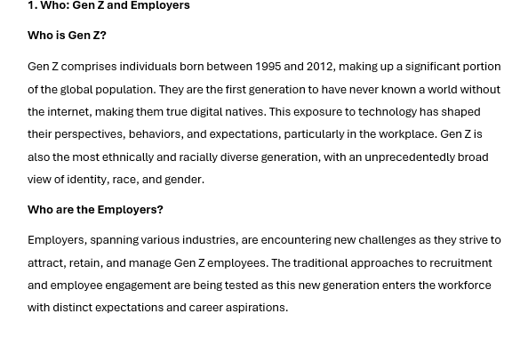
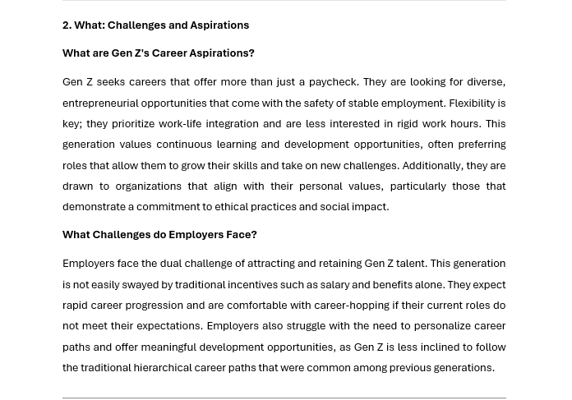
Milestone 1: Problem Statement
Gen Z professionals often struggle to find job opportunities that align with their career aspirations, leading to feelings of being undervalued by employers. Simultaneously, organizations face challenges in attracting, retaining, and effectively managing Gen Z talent due to shifting workplace expectations and values. This disconnect between aspirations and organizational strategies hinders the creation of a mutually beneficial work environment for both job seekers and employers.

Slide 6
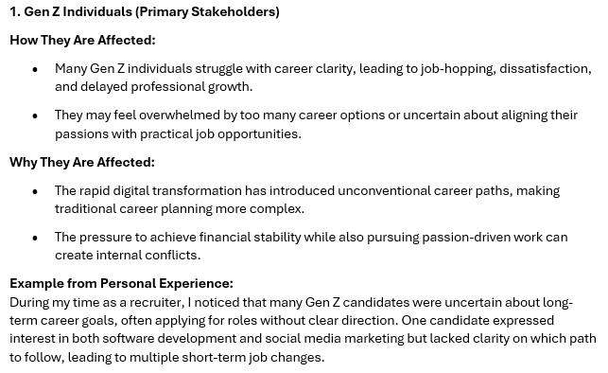
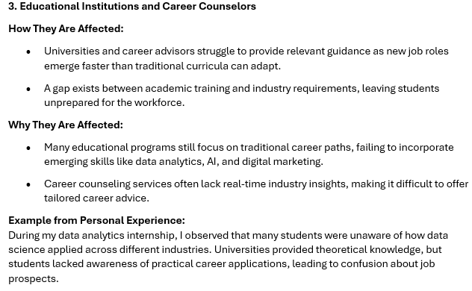
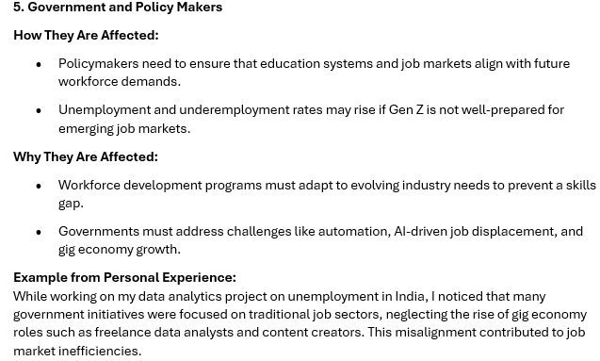
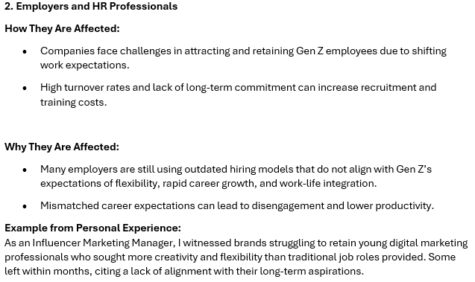
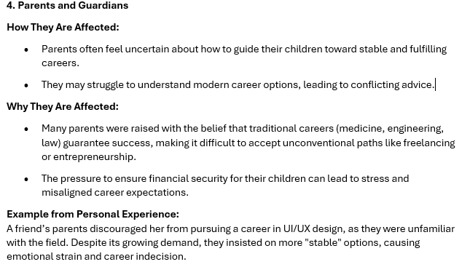
Milestone 2: Stakeholder Analysis

Slide 7
Milestone 3: Data Cleaning and Standardization
1
Handling Missing Values
Identified and treated null or missing values by either inputing them with meaningful data (mean, median, or mode) or removing irrelevant records to maintain data quality.
2
Removing Duplicates
Checked for duplicate records in key columns like respondent ID, career aspirations, and preferences to ensure data integrity.
3
Data Type Standardization
Ensured that all columns had consistent and appropriate data types (e.g., dates formatted correctly, numerical fields properly classified, and categorical variables cleaned).
4
Standardizing Text & Categorical Data
Resolved inconsistent text formats (e.g., different spellings, capitalizations) using trim, lower/upper case functions, and Power Query transformations.
Unified categories (e.g., Remote, Hybrid, and In-Office work preferences were standardized instead of multiple variations like "remote work", "WFH", etc.).
5
Handling Outliers & Data Validation
Identified outliers in numerical data (e.g., unrealistic salary expectations, extreme age values) and either treated or excluded them to ensure accurate analysis.

Slide 8
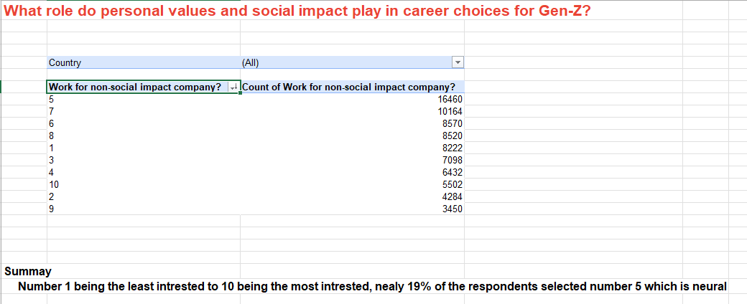
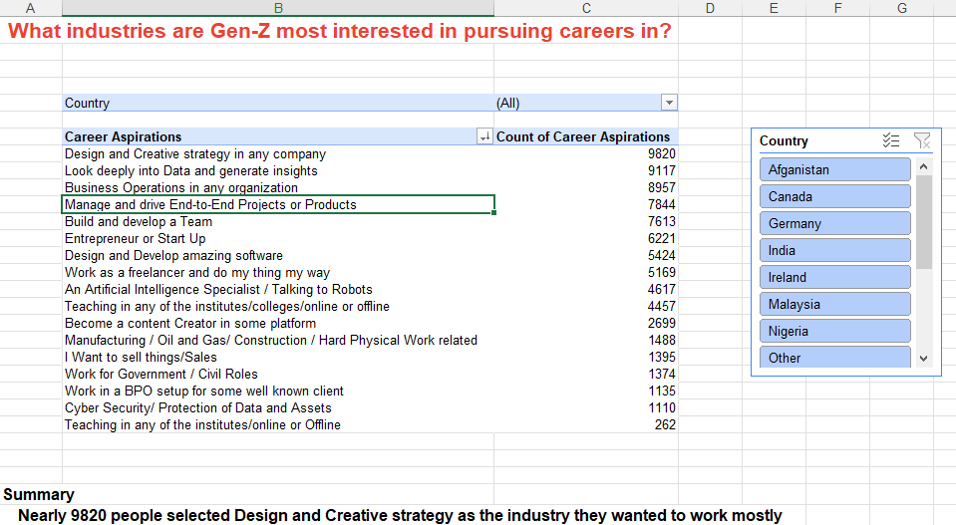
Milestone 4: EDA using Pivot tables

Slide 9
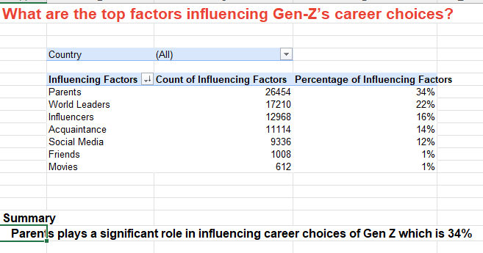
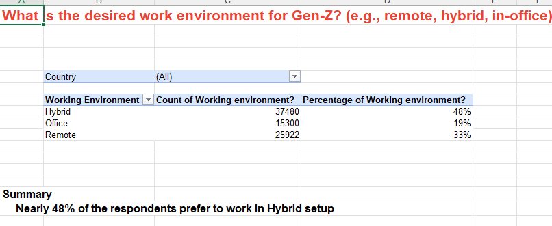
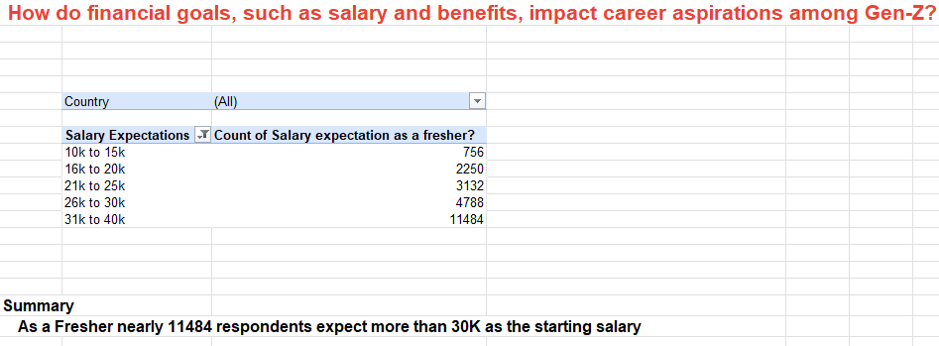

Slide 10
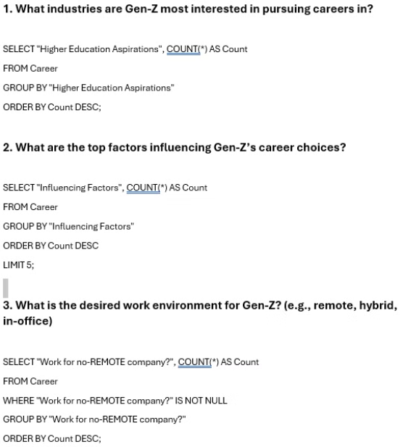
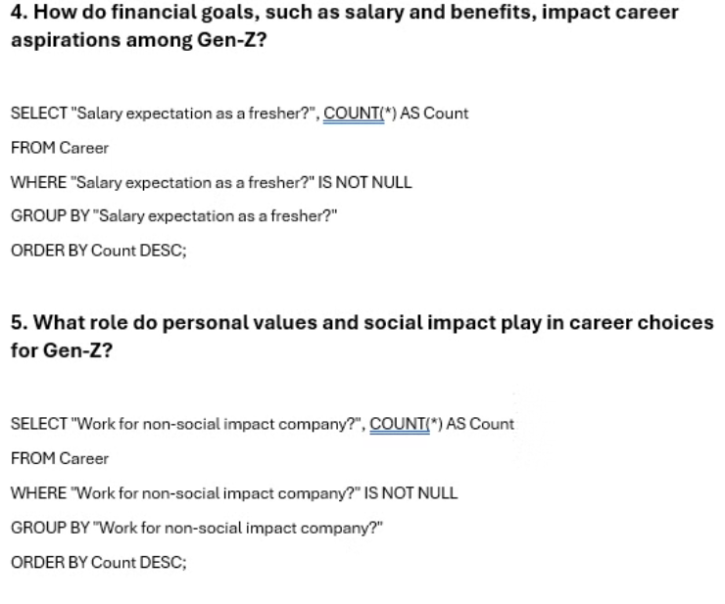
Milestone 5: Data Analysis in SQL

Slide 11
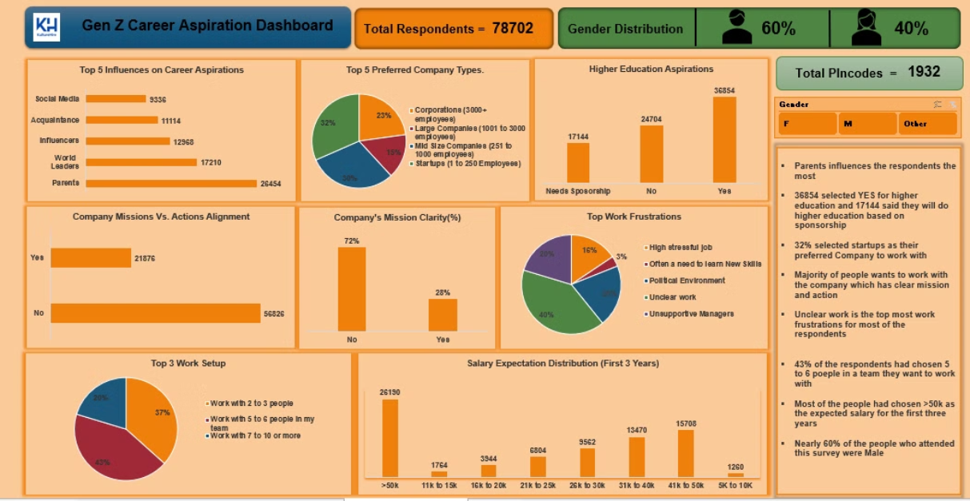
Milestone 6: Executive Dashboard in Excel

Slide 12
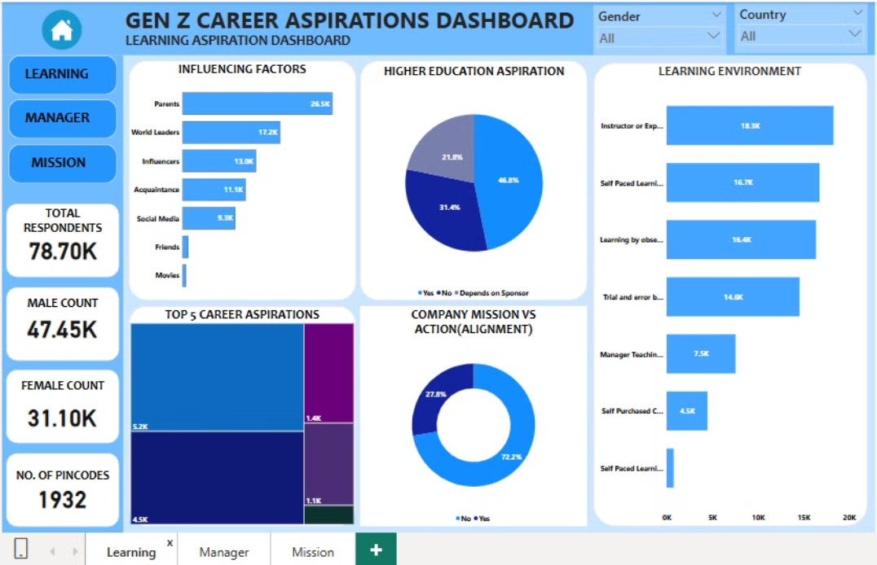
Milestone 7: Functional Dashboards in PowerBI

Slide 13
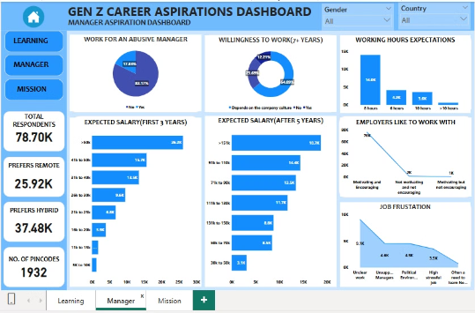

Slide 14
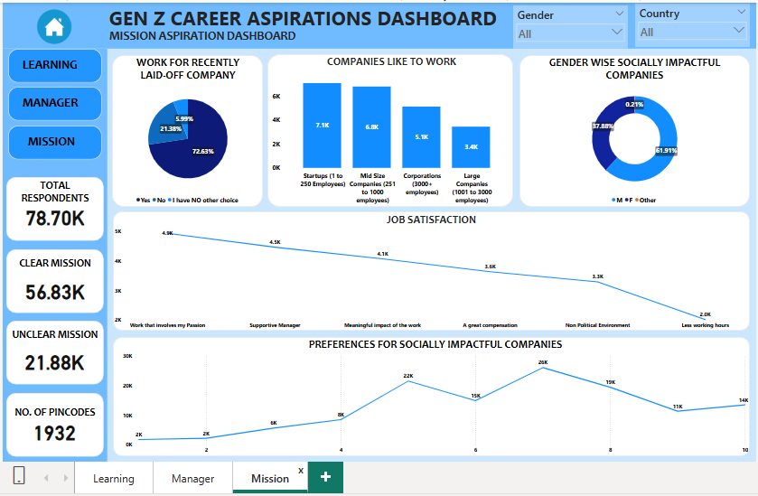

Slide 15
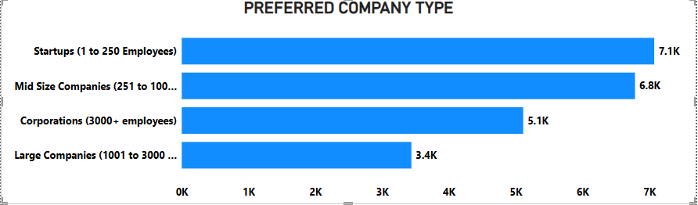
Key Findings: Company Preferences
1
Startups
2
Mid-Size Companies
3
Corporations
Gen Z prefers startups for their innovation, flexibility, and opportunities to take on diverse roles. They value fast growth, creativity, and a dynamic work environment.
These companies offer a balance between stability and agility. Gen Z finds them appealing for structured career growth, better resources, and a collaborative culture..
Large multinational corporations provide security, strong brand reputation, and global exposure. Gen Z sees them as a way to gain experience and credibility in their careers.

Slide 16
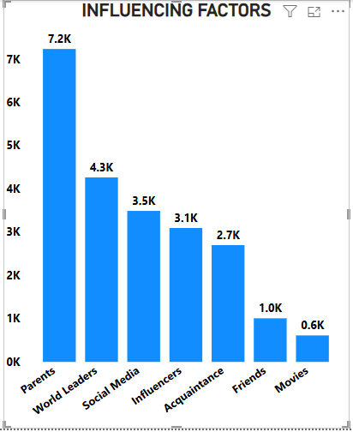
Key Findings: Influencing Factors
Parents (7.24K)
Parents play the most significant role in shaping Gen Z's career decisions, often guiding them based on personal experiences, values, and stability concerns.
World Leaders (4.27K)
Global figures, including political and business leaders, inspire career aspirations through their leadership, success, and impact on society.
Social Media (3.49K)
Platforms like LinkedIn, YouTube, and Instagram expose Gen Z to diverse career paths, trends, and opportunities, influencing their choices through content and success.
Influencers (3.10K)
Digital content creators and industry experts shape career interests by sharing experiences, insights, and unconventional job opportunities.

Slide 17
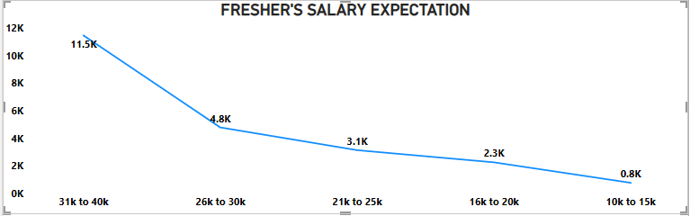
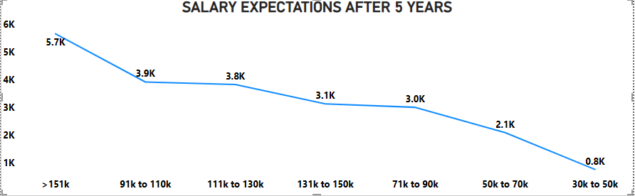
Key Findings: Salary Expectations
Gen Z's salary expectations are influenced by factors such as industry, experience, and location.
Technology and finance industries tend to have higher salary expectations compared to other sectors.
As Freshers they expect starting salary as 3 lakhs to 5 lakhs per annum.
After 5 years the expected salary raises upto 18 lakhs per annum

Slide 18
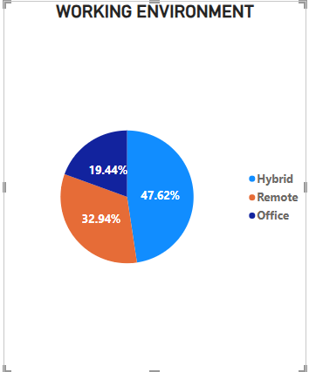
Key Findings: Work Mode Preferences
Gen Z prioritizes flexibility and work-life balance, leading to a strong preference for remote or hybrid work models.
Full-time in-office work is still preferred by some, particularly in fields requiring hands-on collaboration.
47.62% prefers hybrid model and 32.94% prefers remote setup

Slide 19




Key Findings: Skill Acquisition Trends
Gen Z is actively engaged in online learning platforms, seeking to acquire in-demand skills such as coding, data analytics, and digital marketing.
Certifications are highly valued, providing a tangible demonstration of skills and knowledge, making them attractive to Gen Z.
Short-term bootcamps are preferred over traditional degree programs, offering a faster and more focused path to acquiring specific skills.

Slide 20

Project Outcomes
1
Industry Trends
The study reveals that Gen Z is highly inclined towards careers in technology, healthcare, and digital marketing, reflecting the evolving job market.
2
Workplace Preferences
Remote and hybrid work models are preferred over traditional office-based roles, influencing how companies design their work environments.
3
Skill Development
Continuous learning and upskilling play a crucial role in career decision-making, with a strong inclination towards digital certifications.
4
Work Expectations
Gen Z prioritizes flexibility, work-life balance, and career growth over long-term job security, changing traditional employment models.

Slide 21

Project Challenges
Data Limitations
Incomplete or region-specific datasets posed analysis challenges
Data Cleaning Complexities
Standardizing data from multiple sources.
Evolving Workforce Trends
keeping pace with rapidly changing job market dynamics
Survey Bias
Ensuring diverse and representative data collections

Slide 22

Lessons Learned
Real-Time Data Tracking
The study highlights the critical need for real-time data tracking in understanding the dynamic nature of career aspirations.
Interactive Dashboards
Interactive dashboards proved effective in visualizing complex data trends and communicating insights in a clear and engaging way.
Multiple Data Sources
Combining multiple data sources, such as surveys, industry reports, and online learning platforms, provided a comprehensive view of Gen Z career aspirations.
Technological Advancements
The study underscores the significant impact of technological advancements on career aspirations, shaping Gen Z's career choices.

Slide 23




Recommendations for the Future
Periodic Research Updates
Skill Gap Analysis
Enhanced Collaboration
Interactive Career Guidance Tools
Identifying skill mismatches and advising on necessary training programs to bridge the gap.
Encouraging partnerships between academia, industry, and government for workforce development.
Conducting annual surveys to track evolving trends in Gen Z career aspirations.
Implement AI-driven career advisory platforms to support Gen Z professionals.

Slide 24

Conclusion
Gen Z's career aspirations are heavily influenced by digital transformation, flexible work expectations, and evolving professional values. This project provides in-depth insights into their career preferences, enabling stakeholders to adapt their strategies accordingly. By leveraging data analytics and visualization tools, this study presents a data-driven perspective on Gen Z workforce trends. Continuous research is essential to keep pace with changing career dynamics and ensure better alignment between employer expectations and workforce needs.

Slide 25

Thank You
We appreciate your time.
If you have any further questions, please don't hesitate to contact us.

